Slide 1
Robot Project Meeting 12 – 14/02/2019
Bourgogne, Colrat, Evaux, Gaizi, Nicolle – ACE TEAM
Chenaud - PTE

Slide 2
Last Meeting
These were the points discussed:
Organization for Embedded World, seeing with Virgile and Guillaume’s supervisors for them to make the trip
Distribution list with students for AURIX conference access on ishare
Measuring the current consumption in real time using an analog circuit and the ADC – DONE
Fix a cut-off date for the project (around the end of next week February 8th) at which point we will stop implementing and improving and we will focus on cleaning the code and making sure everything works perfectly with the upcoming Robot case – Friday 15/02
Make/add a getting started with AURIX and the robot project guide when we will finish the project
Add as much pictures as possible on the wiki page
To be done:
@Abdoul: Update the students distribution list for access to AURIX conference
@All students: Make a list of possible improvement that are possible to implement before February 8th
@All students: work on the wiki, and pictures if there are not enough already
@Amine & Maxime: work on the current consumption circuit and go to Holger
@Abdoul and/or Virgile/Guillaume: Talk to Ronnie/Stefan for Embedded World trip

Slide 3
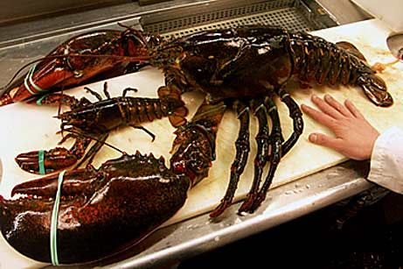
Guillaume, Gyroscope
Done :
All issues have been solved.
Working well (stability correct (0,5 deg-1 deg))
Speed to reach first position correct ~6 sec
Implemented in Amine‘s program and still running well
To do:
Wiki
Deadline: 26/02/2019
Sorry Abdoul

Slide 4
Marlon, PCB
PCB: Done
All parts and wiring are done, awaiting final check
Wiki: Done
Pages update, images and graphs added for clarity

Slide 5
Maxime, Current consumption
Done :
I made 2 current sensors (one for each power supply)
To do :
Wiki page for this part (22/02/19)

Slide 6
Subtasks, Amine
Done
Testing Infineon H-Bridge Kit 2Go
Not convenient for our application: we would need to put 2 H-Bridges (space issue on the soldered board) and adapt logic signals from 5V to 3.3V -> Resistor Bridge. I will still try to implement it
Implementation of the Tft screen in the master project for displaying current consumption and other information
Mode Selector added to the project. The GUI or the App have to specify which mode they want to enable. Therefore, no need to flash a different program for each mode – Partially working, has not been tested exhaustively.
Cleaned the master project as much as possible (useless variables, functions etc)
To Do:
Try to replace the current H-Bridge from STM with the Infineon one.
Deadline 15/02/2019

Slide 7
Bastien: Android App for Remote Control via Bluetooth
Job done :
Decrease of the flow of information sent by the app to the robot (less interruptions called). Same procedure than GUI now.
Ability to launch Mode 2 from the phone.
Button for Mode 3 ready (hidden for the moment : current version is for Embedded World).
Ability to receive data from the robot and treat it.
WiKi page is up-to-date.
Added many comments in the code. (Major part done. Have to keep it updated with new methods.)
To do & to improve :
Find when the App crashes or meets problems by “unexpected use”.
Background color unexpected “problem” (does not have any impact on the use of the apps).
Deadline to finish the V2.0 of the App : 25/02/2018

Slide 8
Virgile, GUI
Done:
Allow keyboard control of the robot in the GUI
Using the Fx keys to control the robot
Make the python GUI into an executable application
Using the pyinstaller module of python
To do:
Resolve the feedback update problem
The data sent by the robot is not updated in the GUI
Finish the wiki of the GUI

Slide 9
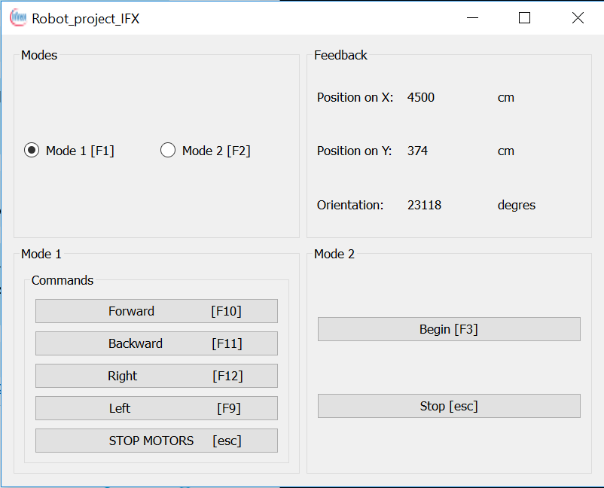
GUI Overview

